Slide 1
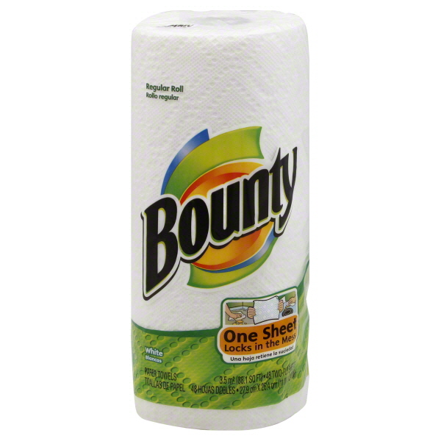
Roll of paper towels

Slide 2
Collection of rolls of paper towels

Slide 3
Can of Coke

Slide 4
Collection of cans of Coke

Slide 5
Egg

Slide 6
Collection of eggs

Slide 7
How to represent a collection of same-type data?
Suppose you need to store 100 years worth of data on the number of cars in SC -- would you define 100 variables?

Slide 8
How to represent a collection of same-type data?
Suppose you need to store 100 years worth of data on the number of cars in SC -- would you define 100 variables?
int y1, y2,..., y100;

Slide 9
How to represent a collection of same-type data?
How would you initialize those variables?

Slide 10
How to represent a collection of same-type data?
How would you initialize those variables?
y1 = 0;
y2 = 0;
y3 = 0;
...
y100 = 0;

Slide 11
How to represent a collection of same-type data?
How would you read in those values?

Slide 12
How to represent a collection of same-type data?
How would you read in those values?
scanf(“%d”, &y1);
scanf(“%d”, &y2);
scanf(“%d”, &y3);
...
scanf(“%d”, &y100);

Slide 13
How to represent a collection of same-type data?
Collection of integers – separate variables for each?
-45 6 0 72 1543 -89 0 62 -3 1 6453 78
int a = -45;
int b = 6;
int c = 0;
int d = 72;
int e = 1543;
int f = -89;
int g = 0;
int h = 62;
int i = -3;
int j = 1;
int k = 6453;
int l = 78;
Notes:
Show memory reserved for each on the board in random locations.

Slide 14
How to represent a collection of same-type data?
-45 6 0 72 1543 -89 0 62 -3 1 6453 78
Give me these numbers in reverse order.
Print these numbers in ascending order.
How about descending order?
- - How to do this??
Notes:
Give me those numbers in reverse order.
Multiple variables to hold all these numbers?
Give me the numbers in ascending order.
Instead of multiple variables with different names, we need a way to hold several variables under the same name.
Show the start of a big if statement?

Slide 15
Introduction to Arrays
An indexed data structure that holds a collection of multiple variables of:
Same type
Same name
Contiguous block of memory
Can manipulate or use
Individual variables or
‘List’ as one entity
A collection of integers. I’ll name it nums.
Type is int.
Notes:
Arrays give us this capability. An array is a collection of variables that have the same name and are all of the same type. When allocated, an array takes up a contiguous block of memory.
Arrays are useful for lists of data such as a list of test scores. It overcomes the problem of allocating multiple simple variables to hold a list.
Once allocated, you can use the individual variables of an array or the entire array as one object.
Perhaps this is an array of Celsius temperatures of type int that we would like to name c in our program.

Slide 16
Declaring Arrays
General Format for declaring arrays:
<data type> <variable> [<size>];
int nums[12];
A collection of integers. I’ll name it nums.
Type is int.
Notes:
That just reserves 12 contiguous memory locations each big enough to hold an int. None of them are initialized yet though.
Show on board.
The size is the number of elements that the array can have.

Slide 17
Declaring and Initializing Arrays
int nums[12] = {-45, 6, 0, 72,
1543, -89, 0, 62,
-3, 1, 6453, 78};
A collection of integers. I’ll name it nums.
Type is int.
Notes:
This is one way to declare and initialize the array on the previous slide.
Show that this is equivalent to:
nums[0] = -45;
nums[1] = 6;
…

Slide 18
Declaring and Initializing Arrays
double taxrate[3] ={ 0.15, 0.25, 0.3 };
char list[5] = { ‘h’, ’e’, ’l’, ’l’, ’o’ };
double vector[100] = { 0.0 };
// assigns zero to all 100 elements
int s[] = { 5, 0, -5 }; // the size of s is 3

Slide 19
Defined Constant as Array Size
Use defined/named constant for array size
Improves readability
Improves versatility
Improves maintainability
Examples:
Notes:
You can use a named constant as the size of an array, either a const or a #define. This helps make the program easier to read. It also makes the program more versatile and maintainable because you can change any reference to the size of an array in one location. If you change the value of the named constant, it will change all statements where it is used.

Slide 20
Multidimensional Arrays
Two dimensions
int a[3][4];
Table, or “array of arrays”; each row is an array

Slide 21
Initializing Multidimensional Arrays
2D example:
Notes:
The second row is missing a value, so it will be initialized to 0.

Slide 22
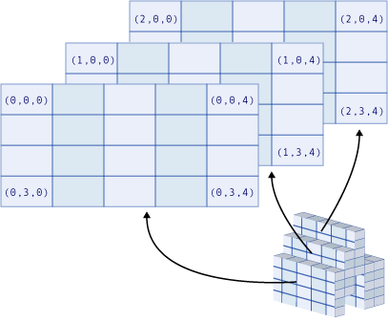
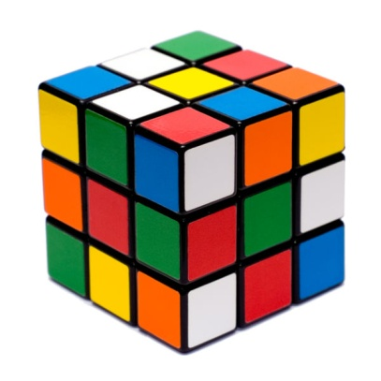
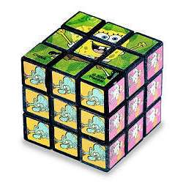
Three-dimensional Visualization
Notes:
You can visualize a three dimensional array as a Rubik’s cube with each cube holding one value inside. The size would be 3 by 3 by 3, height by width by depth. If you separated the cube along one dimension, you would end up with a one-dimensional array or list of tables.
More than three dimensions are harder to visualize. Four dimensions might be a one-dimensional array or list of Rubik’s cubes. Five dimensions would be a table of Rubik’s cubes. Six dimensions would be a Rubik’s cube where each cube is a Rubik’s cube.

Slide 23
Accessing Array Elements
nums
nums[0]
nums[1]
nums[2]
nums[3]
nums[4]
nums[5]
nums[6]
nums[7]
nums[8]
nums[9]
nums[10]
nums[11]
Two uses of brackets:
In declaration, specifies SIZE of array
Anywhere else, specifies a subscript/index
Notes:
Each element can be accessed by its indexed name.
For example:
nums[7] = 12; // would change the 62 to a 12.
if (nums[4] > 1000) …
scanf(“%d”, &nums[9];

Slide 24
Accessing Array Elements
In C, the subscripts always start with 0 and increment by 1, so y[2] is the third element
The name of the array evaluates to the address of the first element
The subscript is the offset
the actual memory address of the element depends on the size of the type of value stored
int y[100];
y[0] y[1] y[2] … y[k-1] y[k] y[k+1] … y[98] y[99]

Slide 25
Accessing Array Elements
list[0]
int list[5];
C does not check bounds on arrays
So, you can write:
list[6] = 5;
will compile
may give segmentation fault
may overwrite other memory locations
list[1]
list[2]
list[3]
list[4]

Slide 26
Assigning values to an array
For loops are often used to assign values to an array.
Example:
int list[5], i;
for(i=0; i<5; i++)
list[i] = i;
list[0]
list[1]
list[2]
list[3]
list[4]
OR
for(i=0; i<=4; i++)
list[i] = i;
0
list[0]
1
list[1]
2
list[2]
3
list[3]
4
list[4]

Slide 27
Assigning values to an array
Give a for loop to assign the below values to list
int list[5], i;
4
list[0]
3
list[1]
2
list[2]
1
list[3]
0
list[4]

Slide 28
Assigning values to an array
Give a for loop to assign the below values to list
int list[5], i;
for(i=0; i<5; i++){
list[i] = 4-i;
}
4
list[0]
3
list[1]
2
list[2]
1
list[3]
0
list[4]

Slide 29
Exercise
Show the contents of the arrays defined in each of the following sets of statements.
int x[10] = { -5, 4, 3 };
char letters[] = { 'a', 'b', 'c’ };
double z[4];

Slide 30
Exercise
int data[100], i;
Store random numbers [0,99] in data
Store random numbers [10,109] in data

Slide 31
Exercise
int data[100], i;
Store random numbers [0,99] in data
for (i=0; i<100; i++)
data[i] = rand() % 100;
Store random numbers [10,109] in data

Slide 32
Exercise
int data[100], i;
Store random numbers [0,99] in data
for (i=0; i<100; i++)
data[i] = rand() % 100;
Store random numbers [10,109] in data
for (i=0; i<100; i++)
data[i] = (rand() % 100) + 10;

Slide 33
Arrays: Powerful Storage Mechanism
Computations on arrays include:
Do this to i-th indexed variable
Fill elements of array scores from user input
Display all elements of array scores
Sort array scores in order
Print the values in reverse order
Determine the sum or average score
Find highest value in array scores
Find lowest value in array scores
Notes:
Once you have an array declared, you can place values in or get values out of individual elements. This allows you to perform subtasks like filling the elements of an array from user input or a file, displaying all of the elements of an array in forward or reverse order, sorting the values of an array in ascending or descending order, determining the sum, average, or some other statistic from the array values, and finding the highest or lowest value.

Slide 34
Review: Accessing Array Elements
Example
Given the declaration
We reference elements of scores by
scores [0]
scores [1]
…
scores [11]
subscript/index
Notes:
Suppose we want an array of 12 test scores. We would declare it with int scores[12]. To get to the first score, we would use a subscript of zero. To get to the second, we would use a subscript of 1.
Since the subscript for the first item is zero, the subscript for the last score will be one less than the size of the array. Since our array has 12 elements, the last element is scores[11]. The last element’s subscript will always be one less than the size. The size will always be one more than the subscript of the last element.
Given our array shown here, what will the printf statement print?
<A subscript of 3 references the 4th element which as a value of 74.>

Slide 35
for-loops with Arrays
Arrays and looping go together
Naturally works well 'counting thru' elements of an array
General form for forward direction
for (subscript = 0; subscript < size; subscript++)
General form for reverse direction
for (subscript = size-1; subscript >= 0; subscript--)
Notes:
Arrays and looping go together. The for loop, in particular, is useful for going through the elements of an array.
To go forward through an array, we start the subscript out at zero, the subscript of the first item. The last subscript for which we want the body of the loop to execute is one less than the size so we want the loop to execute as long as the subscript is less than the size, the number of items in the array. The subscript is incremented each time through the loop.
To go backward through an array, we start out at the last subscript which is the size minus one. The last subscript for which we want the body of the loop to execute is zero so we want the loop to execute as long as the subscript is greater than or equal to zero. The subscript is decremented each time through the loop.

Slide 36
Print Contents of Array
Print forward
int data[100], i;
for (i=0; i<100; i++)
data[i] = (rand() % 100) + 10;

Slide 37
Print Contents of Array
Print forward
int data[100], i;
for (i=0; i<100; i++)
data[i] = (rand() % 100) + 10;
for (i=0; i<100; i++)
printf(“%d\n”, data[i]);

Slide 38
Print Contents of Array
Print backward
int data[100], i;
for (i=0; i<100; i++)
data[i] = (rand() % 100) + 10;

Slide 39
Print Contents of Array
Print backward
int data[100], i;
for (i=0; i<100; i++)
data[i] = (rand() % 100) + 10;
for (i=99; i>=0; i--)
printf(“%d\n”, data[i]);

Slide 40
Find Maximum
Find maximum value in data array
int data[100], max, i;
for (i=0; i<100; i++)
data[i] = (rand() % 100) + 10;
// from 10 to 109

Slide 41
Find Maximum
Find maximum value in data array
int data[100], max, i;
for (i=0; i<100; i++)
data[i] = (rand() % 100) + 10;
max = data[0];
for (i=1; i<100; i++) {
if (data[i] > max)
max = data[i];
}
printf("Max = %d\n",max);

Slide 42
Find average
Find average of values in data array
int data[100], sum, i;
double avg;
for (i=0; i<100; i++)
data[i] = (rand() % 100) + 10;

Slide 43
Find average
Find average of values in data array
int data[100], sum, i;
double avg;
for (i=0; i<100; i++)
data[i] = (rand() % 100) + 10;
sum = 0;
for (i=0; i<100; i++){
sum = sum + data[i];
}
avg = (double)sum/100;
printf(“Avg = %lf\n", avg);

Slide 44
Number of elements greater than average
After finding the average as shown in previous slide ...

Slide 45
Number of elements greater than average
After finding the average as shown in previous slide, use the following code
count = 0;
for (i=0; i<100; i++) {
if (data[i] > avg)
count++;
}
printf(“%d elements are “
“greater than avg”, count);

Slide 46
Find pair sum
Find sum of every pair in data and write into pair array
data[0]=5
data[1]=7
data[2]=15
data[3]=5
…
…
data[98]=3
data[99]=12
}
pair[0]=12
pair[1]=20
…
pair[49]=15
}
.
.
.
}

Slide 47
Find pair sum
int data[100], pair[50], i;
for (i=0; i<100; i++)
data[i] = (rand() % 100) + 1;
for (i=0; i<50; i++){
???
}

Slide 48
Solution
int data[100], pair[50], i;
for (i=0; i<100; i++)
data[i] = (rand() % 100) + 1;
for (i=0; i<50; i++){
pair[i]= data[2*i] + data[2*i+1];
}

Slide 49
Randomly re-shuffle numbers 30 times
data[0]=5
data[1]=7
data[2]=15
data[3]=5
…
…
data[98]=3
data[99]=12
data[0]=12
data[1]=7
data[2]=5
data[3]=15
…
…
data[98]=3
data[99]=5
.
.
.

Slide 50
Randomly re-shuffle numbers 30 times
int data[100], i, j, k, tmp;
for (i=0; i<100; i++)
data[i] = (rand() % 100) + 1;

Slide 51
Solution
int data[100], i, j, k, tmp;
for (i=0; i<100; i++)
data[i] = (rand() % 100) + 1;
for (n=0; n<30; n++){
i=rand() % 100;
j=rand() % 100;
tmp = data[i];
data[i] = data[j];
data[j] = tmp;
}

Slide 52
Exercises for you to think about…

Slide 53
Copy array1 to array2 in reverse order
0
1
2
3
4
5
array1
6
3
1
9
7
2
array2
2
7
9
1
3
6

Slide 54
Print sum of top-bottom pairs
A[0]=3
A[1]=6
…
A[49]=5
A[50]=3
A[98]=4
A[99]=5
+
….
+
+

Slide 55
Group avg
}
Grade[0]
Grade[1]
….
Grade[9]
Grade[10]
…
Grade[19]
Grade[20]
…
Grade[90]
….
Grade[99]
}
Suppose we have a sorted array of hundred grades.
We want to find the average of top ten, second top ten students etc.
}

Slide 56
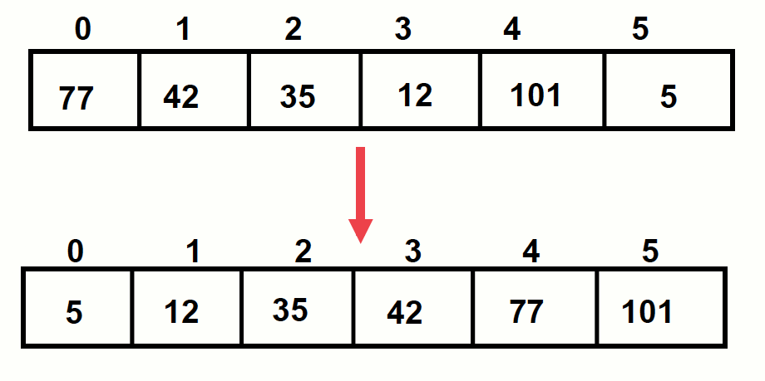
Arrays and Sorting
Sorting takes an unordered collection and makes it an ordered one.

Slide 57
Bubble sort
Traverse a collection of elements
Move from the front to the end
“Bubble” the largest value to the end using pairwise comparisons and swapping
Hungarian Dancers Bubblesort

Slide 58
Bubble sort
Traverse a collection of elements
Move from the front to the end
“Bubble” the largest value to the end using pairwise comparisons and swapping

Slide 59
Bubble sort
Traverse a collection of elements
Move from the front to the end
“Bubble” the largest value to the end using pairwise comparisons and swapping

Slide 60
Bubble sort
Traverse a collection of elements
Move from the front to the end
“Bubble” the largest value to the end using pairwise comparisons and swapping

Slide 61
Bubble sort
Traverse a collection of elements
Move from the front to the end
“Bubble” the largest value to the end using pairwise comparisons and swapping

Slide 62
Bubble sort
Traverse a collection of elements
Move from the front to the end
“Bubble” the largest value to the end using pairwise comparisons and swapping

Slide 63
Bubble sort
Traverse a collection of elements
Move from the front to the end
“Bubble” the largest value to the end using pairwise comparisons and swapping

Slide 64
Bubble sort algorithm (pseudocode)
index <- 0
last_compare_at <- (n – 2)
loop
exitif(index > last_compare_at)
if(A[index] > A[index + 1]) then
swap(A[index], A[index + 1])
endif
index <- index + 1
endloop

Slide 65
Swap, in C:
int temp, a, b;
// swap a and b
temp = a;
a = b;
b = temp;

Slide 66
Swapping array elements
int temp, a, b, collection[10];
// swap collection[a] and collection[b]
temp = collection[a];
collection[a] = collection[b];
collection[b] = temp;

Slide 67
Notice that…
Only the largest value is correctly placed
All other values are still out of order
So we need to repeat this process

Slide 68
How many times to perform bubble-up?
If we have N elements…
and if each time we bubble an element, we place it in its correct location…
then we repeat the “bubble up” process N – 1 times.
This guarantees we’ll correctly place all N elements (numbered 0..(n-1))

Slide 69
“bubbling” all the elements

Slide 70
Bubblesort code
int a[array_size], i, j, temp;
for (i = 0; i < (array_size - 1); ++i){ // for each pass
for (j = 0; j < (array_size - 1 - i); ++j){ // items to compare
if( a[j] > a[j+1]){ // compare pairs
temp = a[j+1];
a[j+1] = a[j];
a[j] = temp;
}
}
}

Slide 71
improvements
What if the collection was already sorted?
What if only a few elements were out of place and after a couple of “bubble ups,” the collection was sorted?
We want to be able to detect this and “stop early”
How to do that?
Notes:
Could keep track of the number of swaps, and if there is an iteration where no swap occurs, the loop should terminate.

Slide 72
Use a boolean “flag”
We can use a boolean variable to determine if any swapping occurred during the “bubble up.”
If no swapping occurred, then we know that the collection is already sorted!
This boolean “flag” needs to be reset after each “bubble up.”

Slide 104
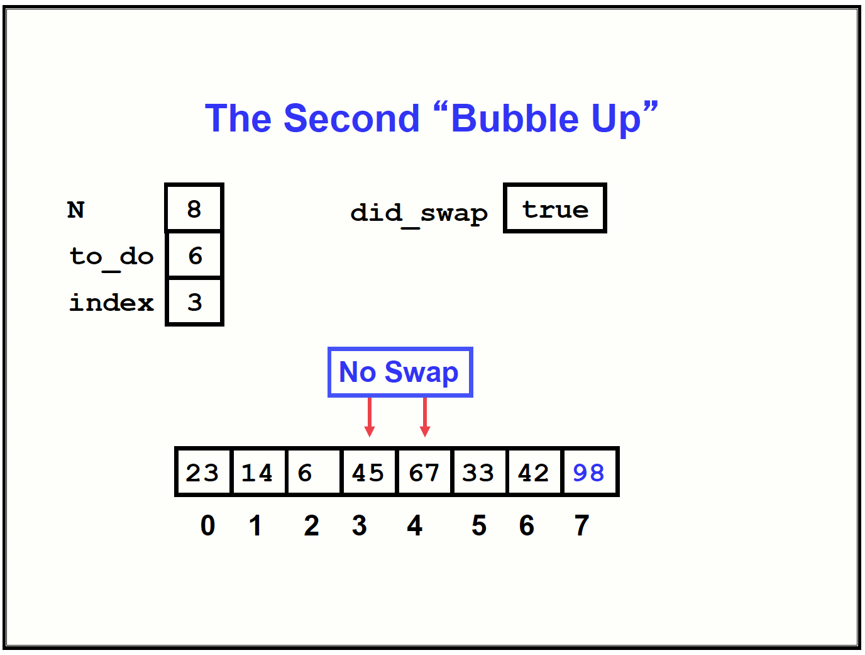

Slide 119
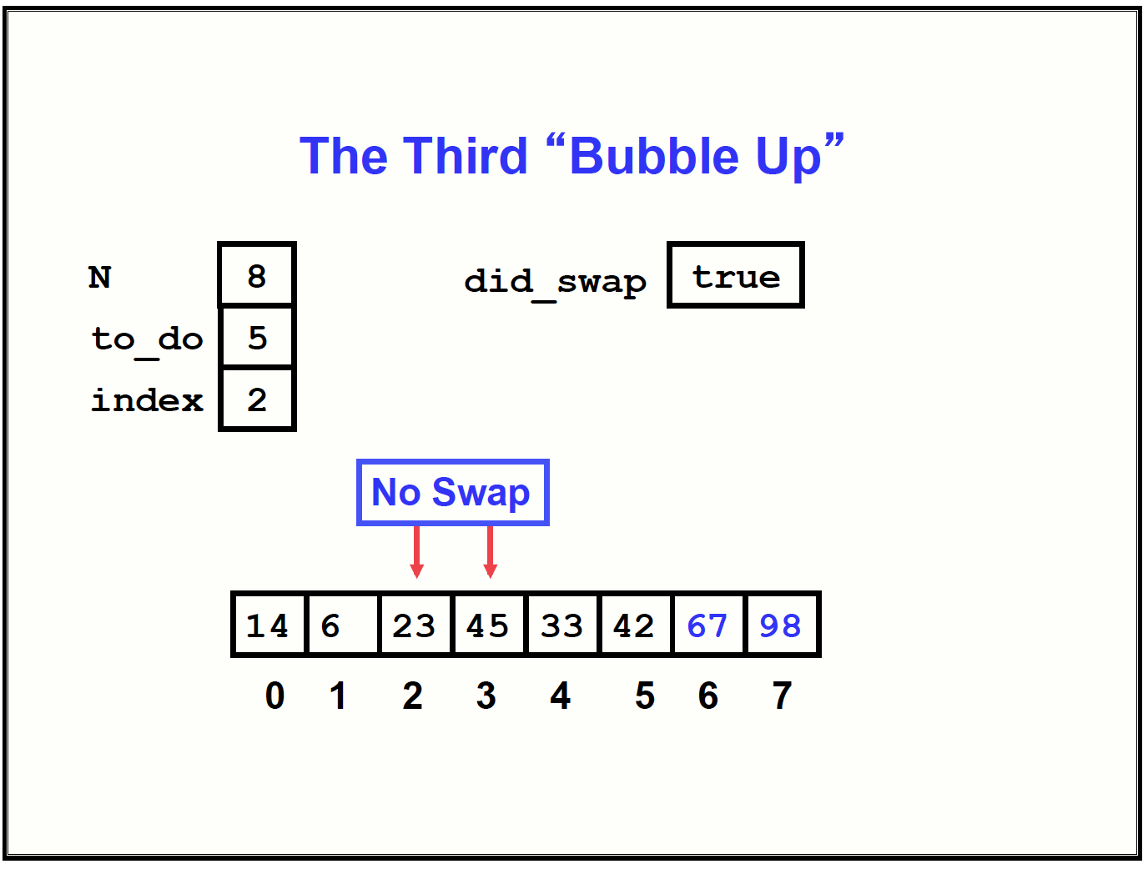

Slide 135
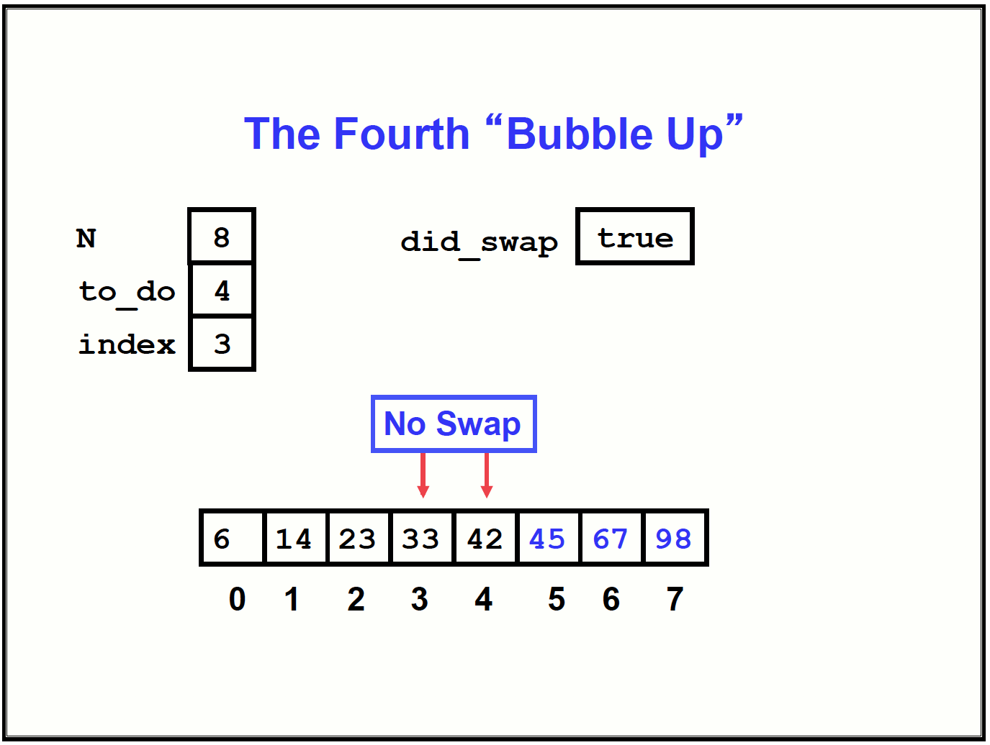

Slide 138
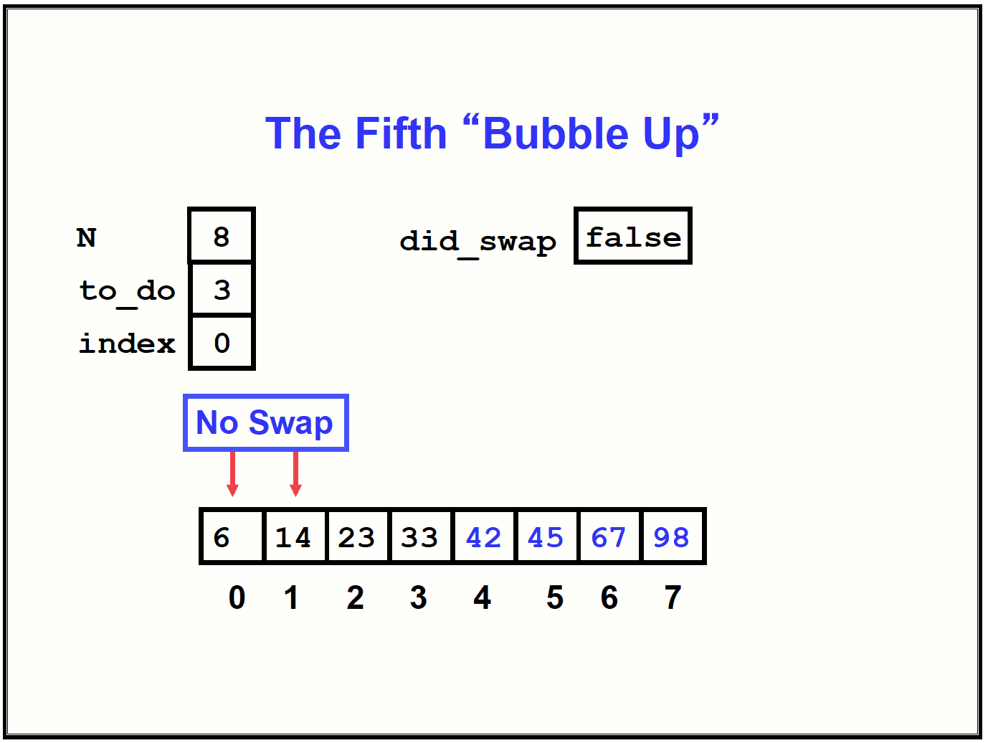

Slide 139
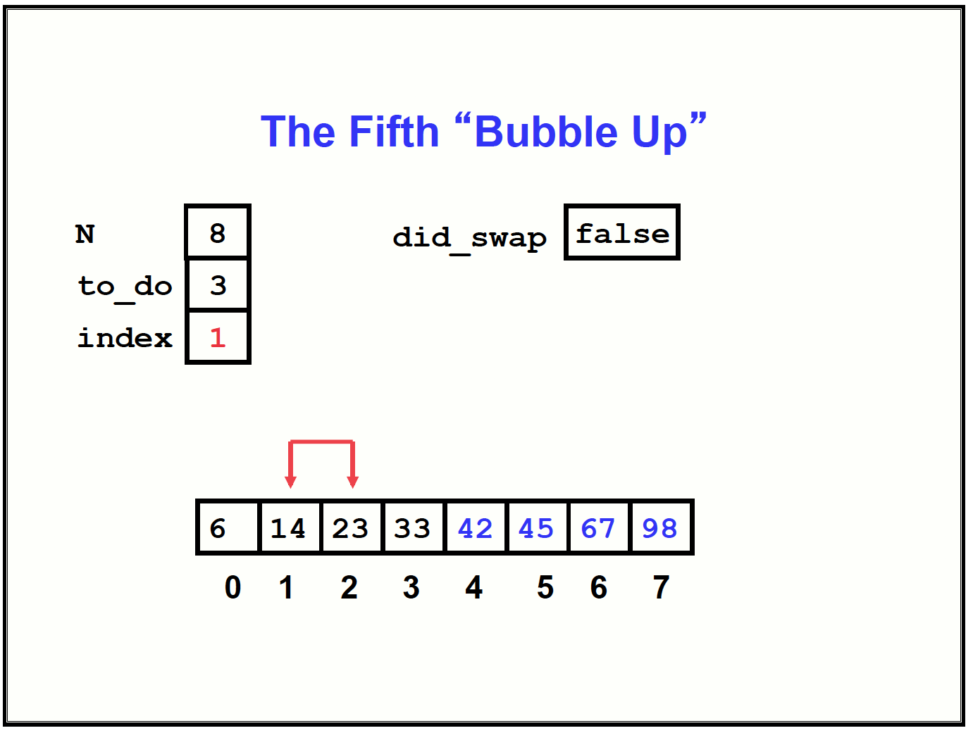

Slide 140
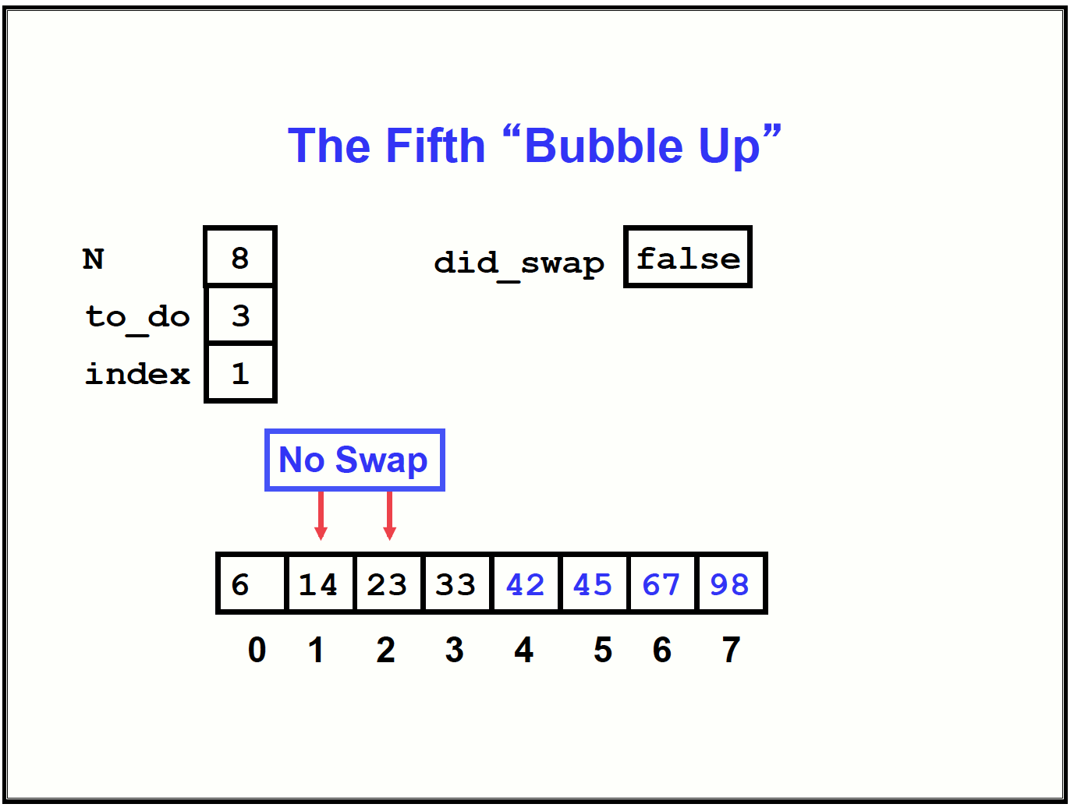

Slide 141
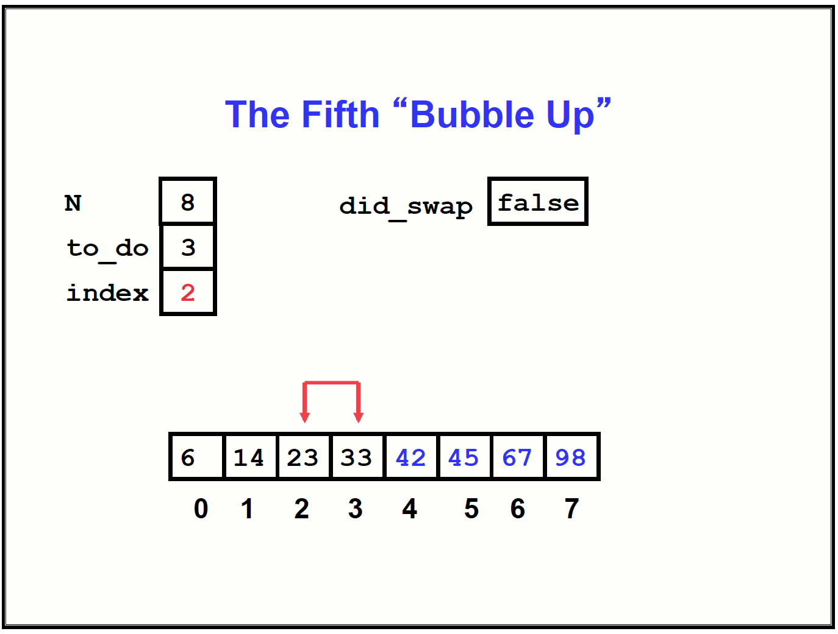

Slide 142
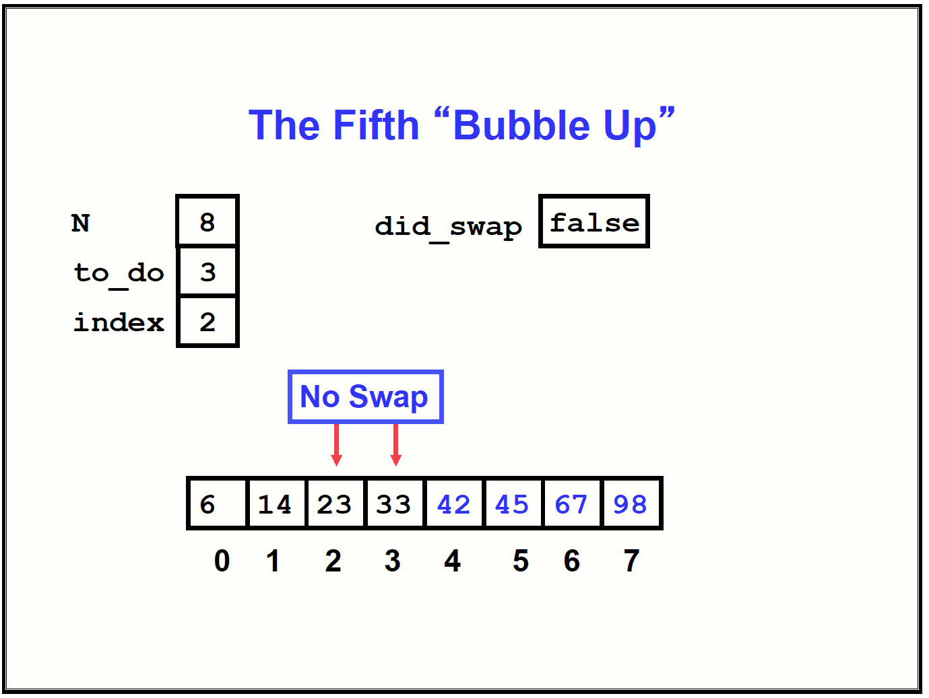

Slide 145
summary
“Bubble Up” algorithm will move largest value to its correct location (to the right)
Repeat “Bubble Up” until all elements are correctly placed:
Maximum of N-1 times
Can finish early if no swapping occurs
We reduce the number of elements we compare each time one is correctly placed

Slide 146
Truth in cs act
Nobody uses bubblesort
Nobody
Never
Because it is extremely inefficient
If you use it at your future job:
– please don’t say you went to Clemson

Slide 147
mergesort
Divide and Conquer
cuts the problem in half each time, but uses the result of both halves:
cut the problem in half until the problem is trivial
solve for both halves
combine the solutions
Merge-sort with Transylvanian-saxon (German) folk dance

Slide 148
Mergesort algorithm
Divide the unsorted array into 2 halves until the sub-arrays only contain one element
Merge the sub-problem solutions together:
Compare the sub-array’s first elements
Remove the smallest element and put it into the result array
Continue the process until all elements have been put into the result array

Slide 187
summary
Divide the unsorted collection into two
Until the sub-arrays only contain one element
Then merge the sub-problem solutions together

Slide 188
Selection sort
Find the minimum value of the list and swap it with the element at the index where it is supposed to go.
The process is repeated such that the nth minimum element is swapped at the n-1th index of the list.

Slide 189
Selection sort
int i, j, min;
double temp;
for(i = 0; i < array_size - 1; i++) {
min = i;
for(j = i + 1; j < array_size; j++)
if(x[j] < x[min])
min = j;
temp = x[i];
x[i] = x[min];
x[min] = temp;
}
find minimum position
swap

Slide 191
Selection Sort (solution 1)
void selection_sort(double x[], int n)
{
int k,j,m;
double temp;
for(k=0; k<=n-2; k++) {
m = k;
for(j=m+1; j<=n-1; j++)
if(x[j] < x[m])
m = j;
temp = x[k];
x[k] = x[m];
x[m] = temp
}
}
m = find_min_pos(x, n, k);
swap(x, k, m);

Slide 192
Selection Sort (solution 2)
void selection_sort(double x[], int n)
{
int k, m;
for(k=0; k<=n-2; k++){
m = find_min_pos(x, n, k);
swap(x, k, m);
}
}

Slide 193
Selection Sort cont’d
int find_min_pos(double fx[], int fn, int fk)
{
int j;
int m=fk;
for (j=m+1; i<=fn-1; j++)
if (fx[j] < fx[m])
m = j;
return(m);
}

Slide 194
Selection Sort cont’d
void swap(double sx[], int sk, int sm)
{
double temp;
temp = sx[sk];
sx[sk] = sx[sm];
sx[sm] = temp;
return;
}

Slide 195
Reverse an array
0
1
2
3
4
5
6
3
1
9
7
2
2
7
9
1
3
6

Slide 196
Reverse an Array
void reverse(double x[], int n)
{
int i=0, j=n-1;
while (i<j) {
swap(x,i,j);
i = i + 1;
j = j - 1;
}
return;
}

Slide 197
Merge two sorted array
Assume we have A and B arrays containing sorted numbers
For example
A = { 3, 5, 7, 9, 12}
B = {4, 5, 10}
Merge these two arrays as a single sorted array C, for example
C = {3, 4, 5, 5, 7, 9, 10, 12}

Slide 198
Search Algorithms
Unordered list
Linear search
In a loop compare each element in array with the value you are looking for (→)
Ordered list
Linear search
A better solution is known as Binary search (but we will skip it this time, it is like looking for a word in a dictionary)

Slide 199
Unordered list – linear search
int search1(int x[], int n, int value)
{
int i;
for(i=0; i < n; i++) {
if (x[i]== value)
return i;
}
return(-1);
}

Slide 200
Ordered list – linear search
int search2(int x[], int n, int value)
{
int i;
for(i=0; i < n; i++) {
if (x[i]== value)
return i;
else if (x[i] > value)
break;
}
return(-1);
}

Slide 201
Exchange Sort Video
https://www.youtube.com/watch?v=v0ipy1h-TPM

